Slide 1

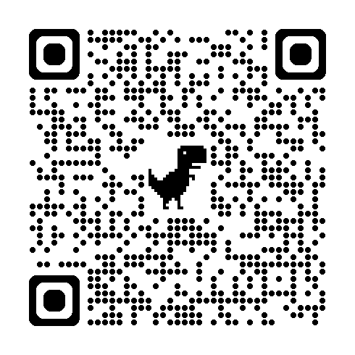

Molecular Biology & Biological Chemistry
https://bioscience.utah.edu/
Over 200 Faculty Members
11 Departments
  Biochemistry
  Biological Sciences
  Chemistry
  Human Genetics
  Medicinal Chemistry
  Microbiology & Immunology, Pathology
  Molecular Pharmaceutics
  Neurobiology
  Nutrition & Integrative Physiology
  Oncological Sciences
  Pharmacology & Toxicology
Online Application
Domestic Application Fee Waiver
December 1 Deadline

